Slide 1

Reading Information Workshop
21st September 2025

Slide 2

Overview
The aim of today’s workshop is to provide you all with information about how we do reading at Haynes – How we teach it, what it looks like and how you can support your child at home.

Slide 3













Your child is already reading and has been for a while – noticing pattern, colour, name recognition and images

Slide 4
Reading wordless books:
Your children’s reading diaries were sent home last week and these will go with them throughout the school.
The next step in your child’s reading journey has started with the wordless books that they have been provided with.
There are instructions for this in the front of each child’s diary but our main aim is for your child to develop a love for reading!

Slide 5

The next step in our reading journey will be learning phonics…

Slide 6
How to say the pure phonic sounds:
https://www.youtube.com/watch?v=IwJx1NSineE
(From 1 minute 30seconds)
https://www.youtube.com/watch?v=KtNWFUVgaRk

Slide 7
Game time!
Grapheme?
Digraph?
Trigraph?
Tricky Word?
Non Tricky Word?

Slide 8
Grapheme | Digraph | Trigraph

Slide 9
Tricky Word | Non Tricky Word

Slide 10
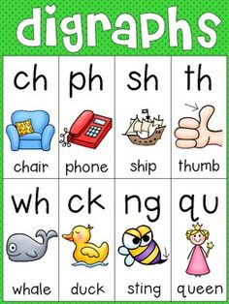

Digraphs / Trigraphs
There are many sounds that have a buddy / friend
We teach the children these to help them with their reading and word recognition…..
2 or 3 letters that make only 1 sound

Slide 11

Reading at Haynes

Slide 12
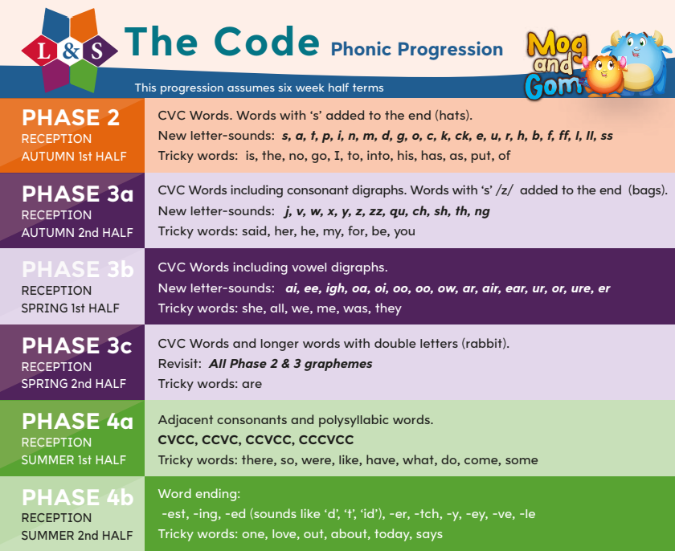

Slide 13
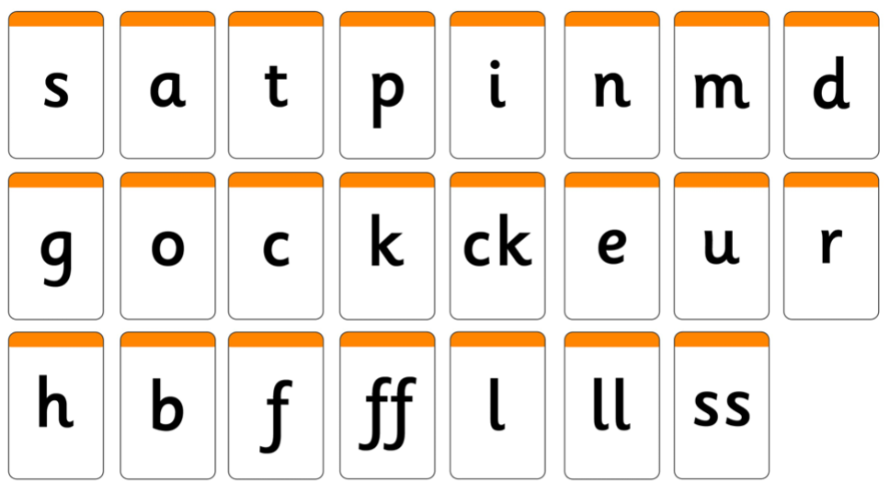
Each of your children have been assessed in their phonics over the last week to provide us with a baseline of what they already know.
Your children will be assessed in their phonics at the end of each half term to assess their sound knowledge, their word blending skills and the tricky words that they can read. This will be recorded in the back of their diaries and you will given the next sounds and tricky words that you can work on with him at home.

Slide 14
In Year R - Phase 2
Sounds s a t p i n m d g o c k ck e u r h b f ff l ll ss
Tricky words is no the go I to into his has as put of cvc words and cvc words with ‘s’ on the end

Slide 15
In Year R - Phase 3A
Sounds j v w x y z zz qu ch sh ch th ng
Tricky words said her he my for be you cvc words and cvc words with ‘s’ on the end

Slide 16
In Year R - Phase 3B
Sounds ai ee igh oa oi oo oo ow ar air ear ar or ure er
Tricky words she all we me was they

Slide 17
In Year R - Phase 3C
Sounds cvc words and words with double letters eg rabbit
Tricky words are

Slide 18
In Year R - Phase 4A
Sounds cvcc ccvc ccvcc cccvcc
Tricky words there so were like have what do come some

Slide 19
In Year R - Phase 4B
Word Endings
-est –ing –ed –er –tch –y –ey –ve –le
Tricky words one love out about today says

Slide 20
Segmenting
Breaking the whole word up into sounds
in…… = i……n
at…… = a…..t
dad……….. = d….a…d
pig………… = p….i….g
bed……….. = b....e…d

Slide 21
Blending explained:
Phonics: How to blend sounds to read words | Oxford Owl

Slide 22
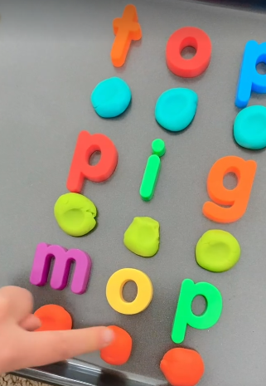
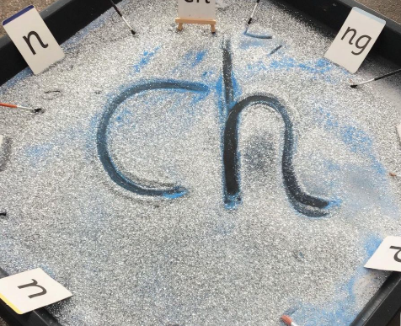
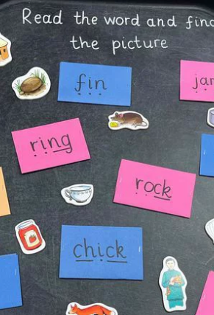
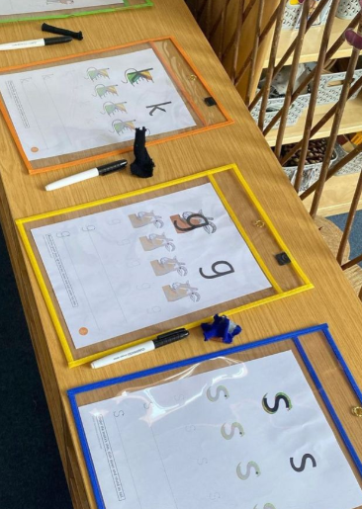
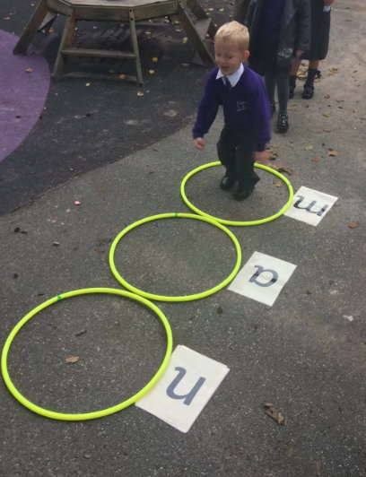
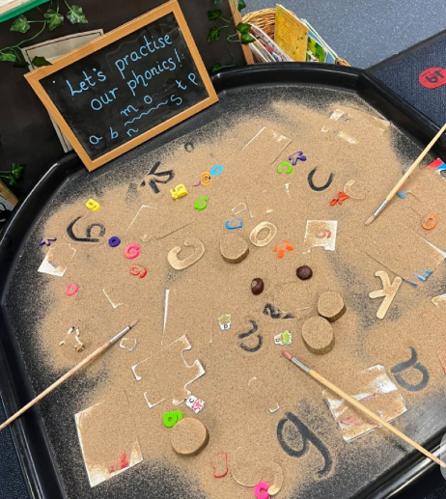
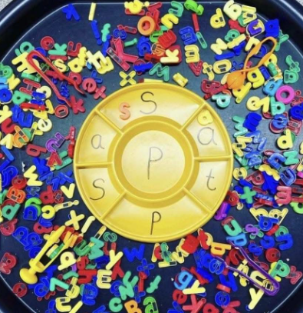

What phonics might look lie at school:

Slide 23
If you wish to watch a few examples of how ‘The Code’ Phonics and Reading sessions are taught, follow this link to some examples on you tube:
https://www.youtube.com/watch?v=nlqMDXWEtXs&t=1s

Slide 24
How to help your child
Talk, listen, question
Read stories all the time
Make up stories all the time
Sound out words
Play I Spy
Practise phonics everyday – 5 mins daily
Write in the green diary
Ask us for advice if you’re not sure

Slide 25

Thank you!

